Slide 1


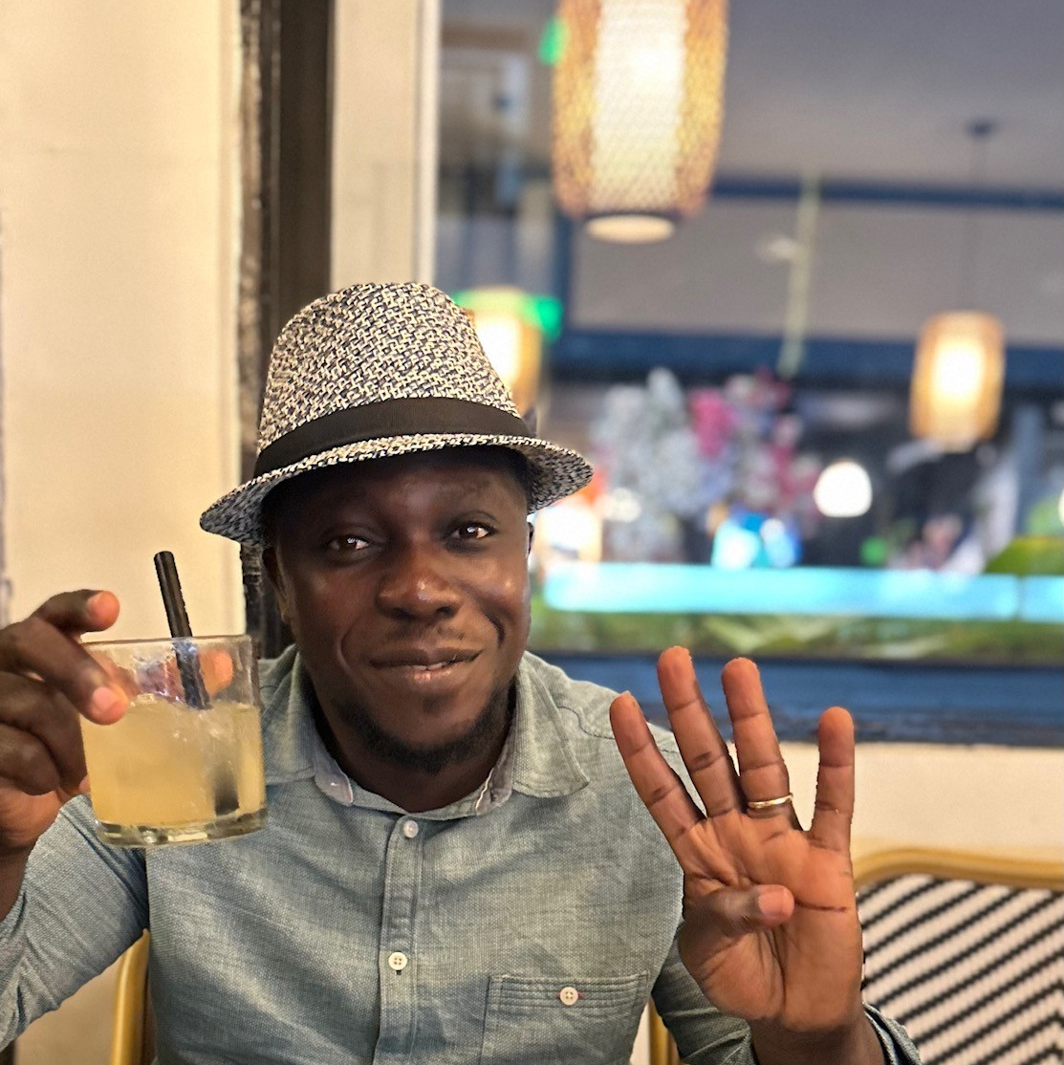
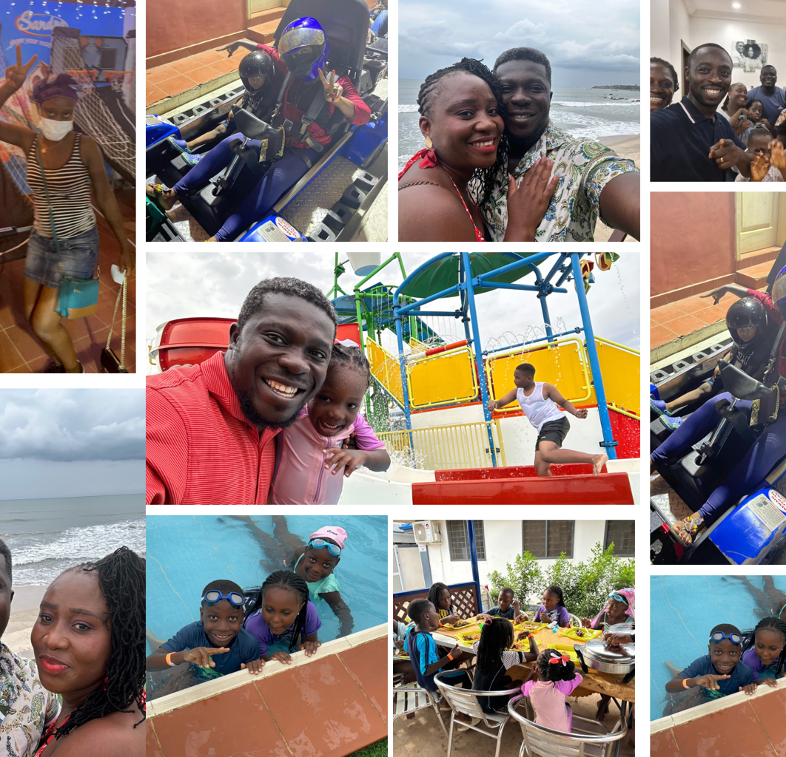
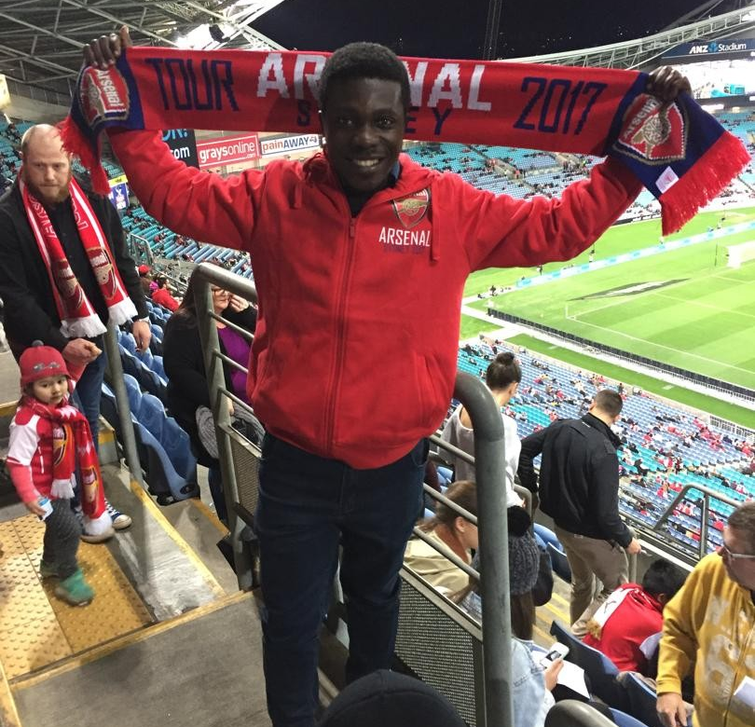
Getting to Know Me
Work
Personal
My role
Regional Enterprise Applications Head
Significant others / family members / furry friends in my life
Barbara-Wife/ Joshua-1st Son/Elijah-2nd Son/Jael- Daughter
Tenure in ofi/Olam
+4yrs
How I enjoy spending my free time
I love spending time with me kids, watching Football & Movies
Previous companies I have worked at
Nestle
Wilmar
My favorite / comfort food
Snail and Mushroom in palm nut soup + konkonte
Why I joined ofi/Olam and what keeps me here?
I was drawn by ofi Global reach, Diverse opportunities and the Strong focus on IT innovations and continuous improvement.
My favorite song
You Always Better – Forrest Frank
Duodu Afari-Prah
‘Afari’
A few fun facts about me
I am a die-hard Arsenal fun who loves geeking out with the lates productivity apps.
Plus I a the cool Uncle who loves having a blast with my Nieces & Nephew.
My perfect weekend ? Football, fun and Family!
This is me outside work, doing stuff I enjoy in my life …

